Slide 1
Management of a Research Program and Utilization of the Result
Prof. Quazi Tarikul Islam
FCPS, FACP, FRCP(G) FRCP(Edin)
Professor of Medicine
Dhaka Medical College

Slide 2
Management of Research Program

Slide 3

What Is Project and Program?
A project is “a temporary endeavor undertaken to create a unique product, service, or result.”
A project ends when its objectives have been reached, or the project has been terminated.
Projects can be large or small and take a short or long time to complete.

Slide 4
What Is Project and Program?
Operations is work done to sustain the business.
Program: “A group of related projects managed in a coordinated way to obtain benefits and control not available from managing them individually.”

Slide 5
What is Management ?
The term “Administrator” and “Manager” are often used synonymously.
But a “Manager' is one who translates policy into action and ensure its implementation with technical skill at any level of function.
There fore, the 'Manager' is the custodian of the research policy and is accountable for all activities including those of entire research team.

Slide 6
What is Project Management?
Project management is “the application of
knowledge, skills, tools and techniques to project
activities to meet project requirements.”

Slide 7
Issues for Research Management
The information base required for policy making and setting priorities for research.
The ethical dimension of research.
Determination of judicious balance for resource allocation among the different type of research needing support. eg- Basic biomedical research, Clinical research, Applied research, Health system research etc.

Slide 8
Issues for Research Management
Determination of resource allocation among the different components of the total research program as well as competing priorities within each components.
Determination of what constitutes innovative research.
Maintaining confidentiality and ensuring scientific integrity.

Slide 9
Issues for Research Management
Failure to learn from predecessors success and failure in management often due to the absence of appropriate records.
Avoiding / resolving conflicts.
Eliciting cooperation, commitment and promoting motivation.

Slide 10
Issues for Research Management
Working towards removing apathy and lethargy of the staff.
Bureaucratic delays and the efficiency and effectiveness of the research process- making the lines of authority as short as possible, with delegation of authority.

Slide 11
Leader and Manager
Leaders are people who do the right things
and
Manager are people who do things right.

Slide 12
Competencies of a Good Manager
A good manager should possess the following four criteria:
Qualities of
  Leadership
  Style of functions
Knowledge and understanding of the application of general principles of management.

Slide 13
Competencies of a Good Manager
Knowledge of the organization one is to serve- “Know your Organization”
Sound knowledge of the specific technical competencies required by the position on holds.

Slide 14
Research Methodology Flowchart
A. PLANNING
1. Organize the research group and advisory committee
2. Determine issues or problems to study and frame research questions around these
3. Develop a research proposal to answer OR/IR questions
4. Obtain ethical clearance
5. Identify funding sources and obtain support for OR/IR
6. Establish a budget and financial management procedures
7. Plan for capacity building and technical support

Slide 15
Research Methodology Flowchart
B. IMPLEMENTATION
8. Monitor project implementation and maintain quality
9. Pre-test all research procedures
10. Establish and maintain data management and quality control
11. Explore together with stakeholders interpretations and recommendations arising from the research findings

Slide 16
Research Methodology Flowchart
C. FOLLOW THROUGH
12. Develop a dissemination plan
13. Disseminate results and recommendations
14. Document changes in policy and/or guidelines that resulted from the research
15. Monitor changes in the revised program
16. Consider ways of improving the program that can be tested through further research

Slide 17
The Triple Constraint
Every project is constrained in different ways by its:
  Scope goals: What work will be done?
  Time goals: How long should it take to complete?
  Cost goals: What should it cost?
It is the project manager’s duty to balance these three often-competing goals.

Slide 18
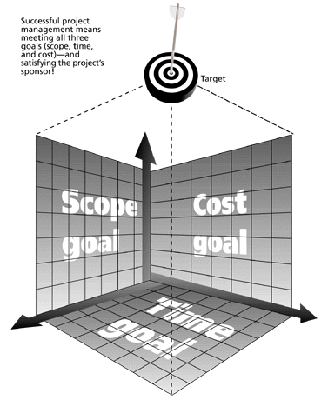
The Triple Constraint of Project Management
Successful project management means meeting all three goals (scope, time, and cost) – and satisfying the project’s sponsor!

Slide 19
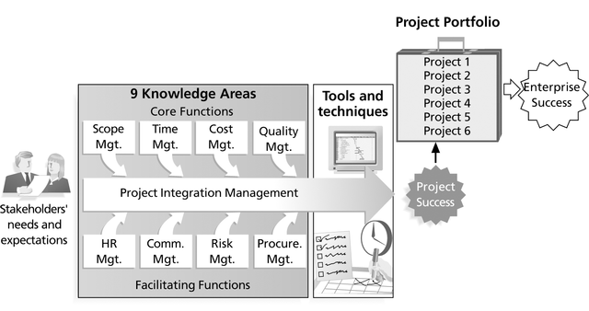
Project Management Framework

Slide 20
Characteristics Project Managers

Slide 21
MANAGER
PROJECT/
PROGRAM
RESEARCH

Slide 22
Field Research
Data and Information
Manager
Looking after the research
Policy Maker
Evaluation
Implementation
Monitoring
Interpretation of Result

Slide 23
Utilization of Research Results

Slide 24
Utilization of Research Results
Introduction
One must aim to transform the research result into a context appropriate to the practical environment.
Research based knowledge generated by researchers needs to be translated in both language and operational activities that are easily understood by the end users.
The ministries of health must, therefore, not only promote and support health research, but must also have an idea why it is being done and what is required form science and scientists.

Slide 25
Utilization of Research Results
Building blocks of utilization modeling:
To develop the knowledge transfer base that underlies utilization, there are five common core elements that are keys to success.
  Source - Where does the research information come from?
  Content - What is the research information about?
  Context - How does the research information relate to existing knowledge or products?
  Medium - How can I get the research information?
  User - How can I benefit from this research information?

Slide 26
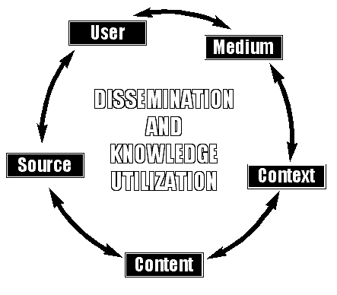
Utilization of Research Results

Slide 27
Utilization of Research Results
SOURCE Where does it come from? | • Perceived competence of researchers and research organization • Credibility of experience of researchers • Credibility of motive • Sensitivity to user concerns and applications • Relationship to other sources trusted by users • Orientation toward use or application

Slide 28
Utilization of Research Results
CONTENT What is it about? | • Credibility of research and development methodology • Credibility of outcomes • Comprehensiveness of research outcomes • Utility and relevance for potential users • Capacity to be described in terms understandable to users • Cost effectiveness • Research design and procedures • Relationship between research outcomes and existing knowledge or available products • Competing or similar research-based knowledge or products

Slide 29
Utilization of Research Results
CONTEXT How does it relate? | • Relationship between outcomes and existing knowledge or products • Current issues in the field • Competing knowledge or products • General economic climate

Slide 30
Utilization of Research Results
MEDIUM How can I get it? | • Physical capacity to reach intended users • Timelines of access • Accessibility and ease of use, user friendliness • Flexibility • Reliability • Credibility • Cost effectiveness • Clarity and attractiveness of the information "package"

Slide 31
Utilization of Research Results
USER How can I benefit from it? | • Perceived relevance to own current needs • User's readiness to change or try something new • Information sources trusted and valued • Format and level of research-based information needed • Level of contextual research-based information needed • Dissemination media preferred • Capacity to use and benefit from research-based information or product (resources, skills, and support)

Slide 32
Utilization of Research Results
Issues related to researchers and research institutes:
  Abstracts and Titles are being too impractical or complicated to be understood by the policy makers and implementers.
  Researchers prefer to work by themselves without consulting the decision makers throughout the process.
  Tend to overlook the relevance of their result to national priorities.
  Use of sophisticated research design so that it can be viewed as high standard research.
  Not mentioning how findings can improve the overall performance.

Slide 33
Utilization of Research Results
Issues related to inter-departmental or inter-ministerial procedures:
  Thin line of communication between the ministry and the researchers
  Researches being done for the sake of researches.
  Not having effective advisory or similar committees for putting research in to practice.

Slide 34
Utilization of Research Results
Issues related to the research policy and planning vis-à-vis national health policy:
  Research is generally not built into the planning process of the national health care system.
  Research policies are not always in consonance with national health policies.

Slide 35
Utilization of Research Results
Issues related to decision makers and program managers:
  Decision makers not perceiving that results from research could substantially contribute for improvement in the effectiveness and efficiency of the health care system.
  Not being aware of the fact that research is one of the important and practical tools to solve administrative and managerial problems.
  Bureaucratic nature of the overall system hampering any form of changes to be made.

Slide 36
Utilization of Research Results
CHALLENGES TO RESEARCH DISSEMINATION
  The overall intention of research dissemination is to initiate the process of getting new knowledge used for the good of the society by increasing the effectiveness and efficiency of the health care system.
  Publication of research findings is part of the career ladder of research scientists.
  While there may be more status attached in publishing in international journals, arrangements must be made to facilitate early dissemination of results in local journals first.

Slide 37
Utilization of Research Results
CHALLENGES TO RESEARCH DISSEMINATION
  High cost and proliferation of professional journals have become important barriers to keeping up with the literature.
  The dissemination of implications of research results, especially health systems research, down to the community level is not being promoted in a simplified form that can be understood by the community, especially in developing countries.

Slide 38
Utilization of Research Results
CHALLENGES TO RESEARCH DISSEMINATION
Careful attention therefore should be given as to
  What, when and how to disseminate the research results
  Intended target population and their level of interest and knowledge
  A mechanism for follow up to study the impact or implications of incorporating the research findings.

Slide 39
Utilization of Research Results
Barriers
Educational preparation and personality factors are important determinants for utilization of research results.
Hunt (1981) suggests that research findings are not used in clinical and public health practice due to the following reasons.
  They do not know them
  They do not understand them

Slide 40
Utilization of Research Results
Barriers
  They do not believe them
  They do not know how to apply them and finally
  They are not allowed to use them
All these factors are equally important in formulating the strategies for improved utilization of research results.
Many studies have been carried out to identify the barriers in utilizing research results. It was found that four main characteristics were responsible for its use (Funk - 1995):

Slide 41
Utilization of Research Results
Barriers
Characteristics of the adopters such as research values, skills and awareness:
  Lack of awareness of research
  Being isolated from knowledgeable colleagues
  Being incapable of evaluating the quality of research
  Unwillingness to change or try new ideas and approaches
  Not seeing the value of research for practice

Slide 42
Utilization of Research Results
Barriers
Characteristics of the organization such as setting barriers and limitations:
  Insufficient authority to change as per the findings of research
  Insufficient time allocated to think new ideas and methods related to research findings
  Non-cooperation or lack of support from professional staff working in the same organization

Slide 43
Utilization of Research Results
  Barriers
  Insurmountable administrative issues arising out of the change
  Inadequate support facilities to implement the change
  Sufficient time to read the research papers
  Non-existence of in-house forum to discuss the research related to its discipline

Slide 44
Utilization of Research Results
  Barriers
  Characteristics of the innovation such as qualities of the research:
    Non-replicability of the results
    Methodological inadequacies of the research
    Late publication of research reports

Slide 45
Utilization of Research Results
    Barriers
    Non-justifiable conclusions drawn from the research
    Conflicting results in the literature review
    Uncertainty about the credibility of the results of the research, were the other factors hindering the use of research results.

Slide 46
Utilization of Research Results
  Barriers
  Characteristics of the communication such as presentation and assessibility of research:
    Inability to understand the sophisticated statistical analyses used
    Lack of clarity regarding implications for practice
    Research reports not being clear and readable, were found to be major factors hindering the use of results.

Slide 47
Utilization of Research Results
Strategies to be taken:
Strategies related to research policy and planning
  Undertaking research planning within the framework of the existing health development program.
  Involving the health program implementation unit or planning cell in the ministry in formulating the research agenda and activities.
  Consulting the decision makers on the proposed research subjects at the very outset and soliciting their guidance.

Slide 48
Utilization of Research Results
Strategies to be taken:
  Participation of the policy makers/ community throughout the research planning process.
  Developing procedures for minimizing bureaucratic delays.
  Advocating and motivating the policy makers and administrators in recognizing the importance of research to solve health problems through informed decision making.

Slide 49
Utilization of Research Results
Strategies to be taken:
Strategies related to prioritization of research areas
  Focusing on priority programs or priority problem areas of respective geographic or administrative boundaries.
  Involving officials from health and related ministries in the research agenda prioritization process.
  Advertising the funding or contracting research on specified priority research areas.
  Developing specific funding criteria emphasizing the utilization aspects.
  Using set criteria for selection of research proposals such as national significance, scientific merit, technical feasibility.

Slide 50
Utilization of Research Results
Strategies to be taken:
Strategies related to quality of research:
  Ensuring high quality of research proposals funded by WHO.
  Ensuring close Connection between objectives, methodology and technical Support.
  Maintaining support and back-stopping throughout the research process from initiation till utilization of research findings.
  Focusing capacity building in specific high priority areas.

Slide 51
Utilization of Research Results
Strategies to be taken:
Strategies related to conduct of research:
  Conducting research on the most Pressing current problems and future needs for health planning and development in a timely manner.
  Conducting research-cum-action type of workshop
  Using simple and understandable research methodology and also not applying complicated statistical techniques if ordinary statistics can instead be applied.
  Proper monitoring and supervision of research using various management tools and relaying the interim result to decision makers.

Slide 52
Utilization of Research Results
Strategies to be taken:
Strategies related to research base:
  Incorporating research utilization themes into the mission statements of the institutions.
  Providing administrative support by
  Developing quality research proposals on issues of contemporary importance and systematic follow up.
  Development of research utilization mechanisms.

Slide 53
Utilization of Research Results
Strategies to be taken:
Strategies related to dissemination of research finding:
  Compiling and computerizing research results by research councils/centers with built-in mechanism for dissemination.
  Setting up special bulletin boards for showing research findings of current interest to staff of the organization
  Promotion of simplified and high profile advocacy news letter for officials.
  Conducting research forum workshops involving WHO.

Slide 54
Utilization of Research Results
Strategies to be taken:
Strategies related to translation of new knowledge into practice:
  Establishing a permanent, built-in mechanism to relay relevant findings of research to decision / policy makers / program managers / pubic health workers.
  Making the research based recommendations as simple and practical as possible, taking into account the existing the health care system.
  Developing a validation system for research findings of national and regional significance and preparing research journals

Slide 55
Take home messages:
A good research manager should have, leadership, good style of function, knowledge of general management and adequate competencies
Pubic health research program can be conceptualized as a pyramid the base is research knowledge.
Pubic health information and documentation systems serve as a supporting pillar.
Quality and cost effectiveness from the top of the pyramid.

Slide 56
Take home messages:
Research based practice is a necessity specially in today’s health care climate with its increasing demand for high quality and cost effective health care.
Research finding must be understood and implemented by health managers of all level of the health care system.
Research utilization attitude should be influenced by the end users and this development dose not occur rapidly and require commitment and willingness to learn.

Slide 57
Utilization of Research Results
It can be stated that applying research findings in clinical and public health practice perhaps the biggest challenges facing by all of us.

Slide 58
Thank you very much

